Slide 1
INTRO TO
SOCIAL ENGINEERING &
OPEN SOURCE INTELLIGENCE
by Yianna Paris - @x0dium

Slide 2
Notes:
Ocean’s 8
Mr Robot

Slide 3
Notes:
To learn more about sociial engineering
Read the book - The Art of Human Hacking, by Chris Hadnagy, a social engineer and cyber security consultant
Has to do with talking to people and influencing people

Slide 4
Think about your connection with people. “Leave them feeling better for having met you.”
- Chris Hadnagy
Notes:
Whenever I think of a social engineer, I think of someone trying to influence another person. Sometimes it’s for good, and sometimes it’s for bad – but even that’s pretty subjective. We’ll explore a bit more about what that means.

Slide 5
THE SOCIAL ENGINEER
Notes:
Everybody has some idea what this means
I feel like social engineers get a bad wrap
Lots of press about it, lots of fear still especially with the pandemic and everyone WFH
So when we talk about social engineering, there’s usually a few areas discussed:

Slide 6
THE SOCIAL ENGINEER
Phishing
Notes:
Phishing is where someone tries to illicit sensitive information from a target, often done by email

Slide 7
THE SOCIAL ENGINEER
Phishing
Vishing

Slide 8
THE SOCIAL ENGINEER
Phishing
Vishing
SMiShing

Slide 9
THE SOCIAL ENGINEER
Phishing
Vishing
SMiShing
Impersonishing

Slide 10
THE SOCIAL ENGINEER
Phishing
Vishing
SMiShing
Impersonation

Slide 11

THE SOCIAL ENGINEER
Phishing
Vishing
SMiShing
Impersonation
Notes:
Big bad social engineer
We often don’t know the value of the information we have and how that can be used

Slide 12
Children
Grumpy
Pouty
Cry
Notes:
Parents, guardians or teachers want to make them feel happy

Slide 13
Notes:
This is the moment, the connection that you both remember
They remember how good it feels, and it’s probably why they’re okay with pouting in the first place
But this also works both ways
Kids want to feel approval from their parents
Parents may reward good behavior in various ways, or behavior they want to encourage

Slide 14
You just got called for an interview
Notes:
One thing that has always been instilled in me – do your research!
Company culture etc
What kind of language do they use? And I don’t just mean programming languages

Slide 15
OSINT
Open Source Intelligence
Information that is accessed publicly
Notes:
OSINT focuses on anything that can be accessed publicly
Only use Google and tools that do not gain access to private information
Doxxing – truly public

Slide 16

The interview
Notes:
Talk about how great you are
Talk about how great the company is
Everything you know about it because you did your homework
Use your influence

Slide 17
Congrats, you just social engineered your way into a job :)
Notes:
Someone might not remember what you did but they’ll remember how you made them feel
What if influencing people was all about the connection we make with them
The people who interviewed you will always remember the impact you made on them
You left them feeling happier or more inspired for having met you
Thinking about your success in getting the job, you will always remember how that feels
You’ll be more likely to do the same things for your next job

Slide 18
PRETEXT
Confident
OSINT
Simple
Notes:
All of this together creates a pretext

Slide 19
MOTIVATIONS
Politics
Money
Fame

Slide 20
MOTIVATIONS
Politics
Money
Fame

Slide 21
Cool, why does it matter?
We’re all virtual
Information = value
Path of least resistance

Slide 22
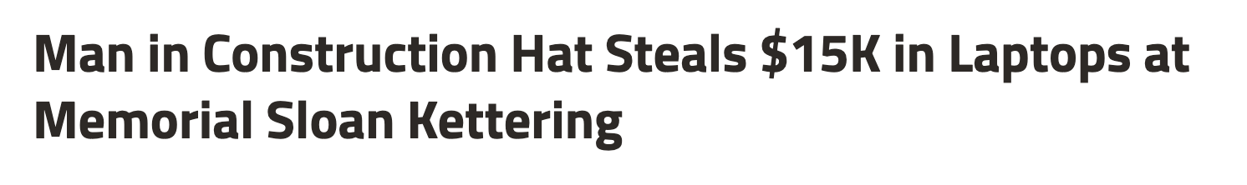
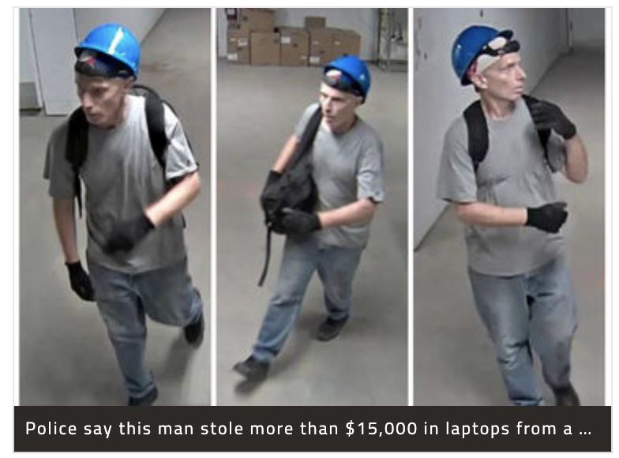
https://www.dnainfo.com/new-york/20170705/lenox-hill/burglar-construction-hat-steals-laptops-memorial-sloan-kettering-cancer-center/
Notes:
Physically pentesting – what about digitally?
It’s kind of easy to imagine what it’s llike when somebody is impersonating to look as if they’re meant to be there. They might dress up like a cleaner or construction worker, perhaps act like they’re from IT support. They’ll make sure they look the part, try to hide their panic. But what about online?

Slide 23
Notes:
Browser vulnerabilities

Slide 24

Notes:
Knowing you have certain programs that you use in your day to day, perhaps trying to send you compromised documents

Slide 25

Notes:
Ever complained about a service being down? Maybe Slack or Teams was playing up and you’re complaining about it on social media – this is super useful if somebody wanted to impersonate an employee or support

Slide 26

Notes:
Phishing emails – popular places you shop, think about what would be really popular right now – Aus Post, Ebay, Jb Hifi, Uber Eats

Slide 27
What about Social Engineering and OSINT for “good”?
Notes:
Information about technology and why it’s valuable
VPN
OS
Schedule
Type of information stays secure

Slide 28

SECURITY AWARENESS
Phishing email to 1000 employees
Email looked legit
750 people clicked
Credentials GOT
Secondary objective
Notes:
I love listening to a podcast named Darknet Diaries
Chris Hadnagy is a cyber sec consultant
So security awareness at a company – people clicking on a phishing email – 1000 people, win a brand new iphone
Put in credentials, corporate sponsored (looked like a corporate site)
Email looked legit - heck yeah, I want to win it!
750 clicked – go to the site – got their work username and password
Security awareness could have ended there, but there was a second objective
Gain remote access to the network inside
Created a PC cleaner program for them, but it was actually -
52:41
phished

Slide 29
SECURITY AWARENESS
Phishing email to 1000 employees
Email looked legit
750 people clicked
Credentials GOT
Secondary objective
Notes:
Darknet Diaries
So security awareness at a company – people clicking on a phishing email – 1000 people, win a brand new iphone
Put in credentials, corporate sponsored (looked like a corporate site)
Email looked legit - heck yeah, I want to win it!
750 clicked – go to the site – got their work username and password
Security awareness could have ended there, but there was a second objective
Gain remote access to the network inside
Created a PC cleaner program for them, but it was actually -
52:41
phished

Slide 30
SECURITY AWARENESS
Phishing email to 1000 employees
Email looked legit
750 people clicked
Credentials GOT
Secondary objective
Notes:
Darknet Diaries
So security awareness at a company – people clicking on a phishing email – 1000 people, win a brand new iphone
Put in credentials, corporate sponsored (looked like a corporate site)
Email looked legit - heck yeah, I want to win it!
750 clicked – go to the site – got their work username and password
Security awareness could have ended there, but there was a second objective
Gain remote access to the network inside
Created a PC cleaner program for them, but it was actually -
52:41
phished

Slide 31
SECURITY AWARENESS
Phishing email to 1000 employees
Email looked legit
750 people clicked
Credentials GOT
Secondary objective
Notes:
Darknet Diaries
So security awareness at a company – people clicking on a phishing email – 1000 people, win a brand new iphone
Put in credentials, corporate sponsored (looked like a corporate site)
Email looked legit - heck yeah, I want to win it!
750 clicked – go to the site – got their work username and password
Security awareness could have ended there, but there was a second objective
Gain remote access to the network inside
Created a PC cleaner program for them, but it was actually -
52:41
phished

Slide 32
SECURITY AWARENESS
Phishing email to 1000 employees
Email looked legit
750 people clicked
Credentials GOT
Secondary objective
Notes:
Darknet Diaries
So security awareness at a company – people clicking on a phishing email – 1000 people, win a brand new iphone
Put in credentials, corporate sponsored (looked like a corporate site)
Email looked legit - heck yeah, I want to win it!
750 clicked – go to the site – got their work username and password
Security awareness could have ended there, but there was a second objective
Gain remote access to the network inside
→ Click next one (for secondary objective)
Created a PC cleaner program for them, but it was actually -
52:41
phished

Slide 33
GET REMOTE ACCESS FROM INSIDE THE NETWORK

Slide 34
HOW?
WITH A METERPRETER REVERSE SHELL

Slide 35
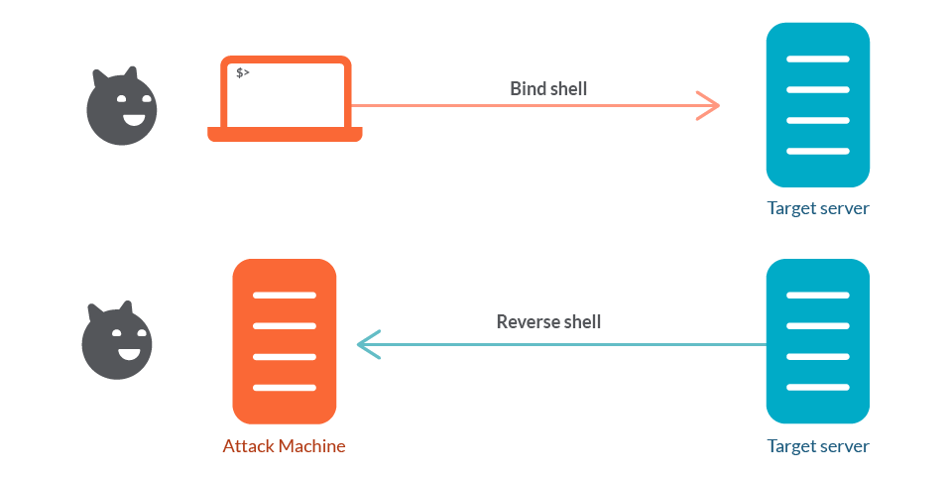
https://sysdig.com/blog/reverse-shell-falco-sysdig-secure/
Notes:
This is a way an attacker can get interactive access into a system
There are a lot of issues with this
Imagine them gong through your directories
Gathering research about you, company files and directories
Or trying to escalate privileges

Slide 36
Open port that is listening
User initiates connection request
https://sysdig.com/blog/reverse-shell-falco-sysdig-secure/
Notes:
If an attacker was to initiate that connection request
It needs somewhere to connect to
So a port needs to be open and listening
It's like hey, here is a phone number you can reach me directly! It's ready to get your call, I just need to pick up and approve it

Slide 37
Open port that is listening
User initiates connection request
https://sysdig.com/blog/reverse-shell-falco-sysdig-secure/
Notes:
But many companies only allow certain ports to be open
So that can be pretty difficult

Slide 38
Open port that is listening
User initiates connection request
https://sysdig.com/blog/reverse-shell-falco-sysdig-secure/
Notes:
What if the opposite was true? What if me as a hacker, my machine had an open port ready to accept a connection request from the target's machine?
this is a reverse shell, but we need to get the program on the target's machine

Slide 39
HOW?
WITH A METERPRETER REVERSE SHELL
Need some good recon to understand target system

Slide 40
Okay, but HOW?
CREATE A CONNECTION WITH THE PERSON
(<_<)

Slide 41
Okay, but HOW?
SEND AN EMAIL
FOLLOW UP CALL
EMPATHY
Notes:
Call 25 people
Convince them to click some malware
Vishing
Email:
Here's an excerpt from Darknet Diaries
Let's have a think about that call - there's a pretext, Chris sounds pretty confident (blase about the siituation), he has a good bit of osint, and there was one clear goal - get the program on to the victim's desktop

Slide 42

TRACE LABS
Crowdsourced OSINT for
Missing Persons
Notes:
How can I practice these skills?
What am I doing with Trace Labs?
Purpose – they help find and reunite people
What it is and how (technically and high level)

Slide 43
Examples of flags in a CTF
Decrypt a sound file
Exploit a server
Exploit a web page
Reverse engineer a file
Find a secrets.txt
Notes:
Some pieces of information to consider
Compare it to a traditional ctf
We might all be familiar with the traditional CTF’s, go do a thing, pentest, find a file, decrypt a file … find a code and submit the flag

Slide 44
Examples of flags in a Trace Labs CTF
Social Media Account
Location
Phone model
Tattoos
Piercings
Notes:
Incentivised – turning it into a CTF, where you receive points for every piece of information that you find
It’s basically gamified, but focused on finding real people

Slide 45
How I Approached It
Stick with what I know
Have a method
Drink lots of coffee
Notes:
Have a method
Be able to pivot then go back to that method
Tools you can use
At least this is how I thought I should approach it

Slide 46
How I Approached It
Know the story
Create connections
Look for details
Notes:
Know the story – articles
Create connections between the pieces of information you’re gathering
And look for the details, maybe there’s a landmark in a selfie and you can locate them with google maps
Clear lines you don’t want to cross
Just because info is there, it doesn’t mean it’s yours to find
Strictly no contact in the Trace Labs CTF
Real people with real lives, we don’t want to harm them or ourselves
https://osintframework.com/

Slide 47
Had my tools ready

Slide 48
Had my tools ready
Notes:
Slowly finding flags at 4am
Using lots of google, breached data etc
Information you might not think is relevant but actually is
Username : social media sites (network of people on insta/facebook would be different to cashapp and dating website, but there might be some crossover – venn diagram?)
Username: breached data : dating website – more to the story to add

Slide 49
How We Actually Did It
Stick with what I know
Have a method
Drink lots of coffee
Empathy
Team
Notes:
I have a team
I shared some tools with them all
Effect was so positive
So many social media accounts suddenly

Slide 50
How We Actually Did It
Stick with what I know
Have a method
Drink lots of coffee
Empathy
Team
Notes:
Strengths
Team generated leads
I had the empathy and perspective to create stories, connections between people

Slide 51

Notes:
Points going up
Momentum
Went to the bigger community
We were on a roll
Points after points getting accepted by the judge
The team was starting to feel empowered and encouraged

Slide 52

Notes:
It’s 7am and we’re getting tired, on to our 5th coffee
It’s been quiet for a couple of hours, things are becoming more real

Slide 53
4,498,300,000
High scores = everyone wins
Notes:
Simon story – high scoring game
This isn’t just like any competition
No matter who wins – really we all win
So we got on to the Trace labs slack
Knowledge sharing
Things we didn’t realise were flags, actually counted

Slide 54
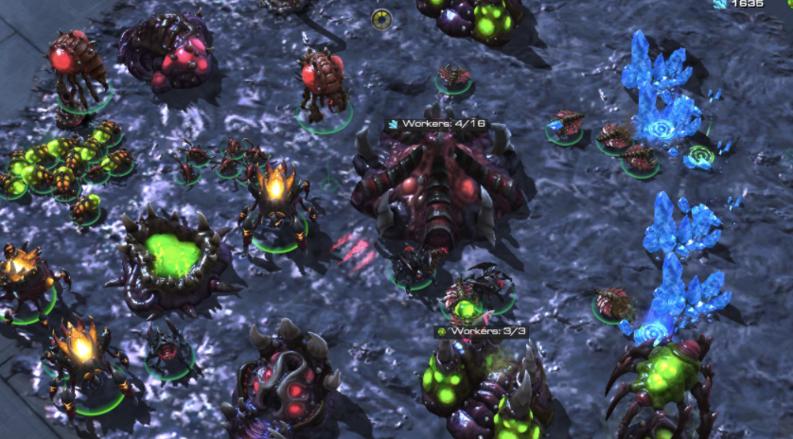


Notes:
My strengths – video games

Slide 55
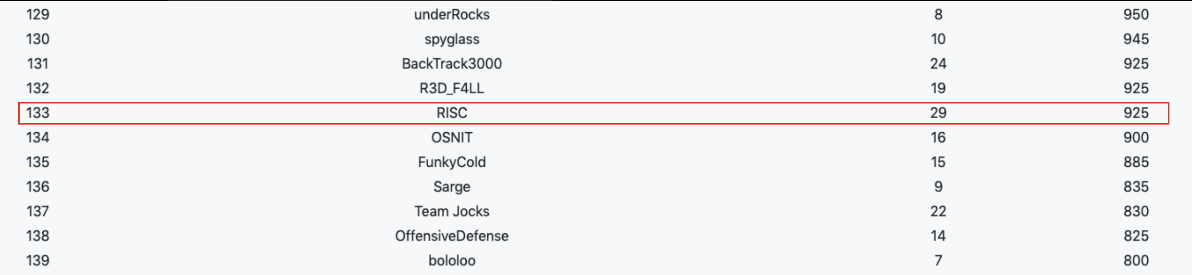
#133 out of 199 teams!
Notes:
Results of two trace labs
2 out of the 5 cases

Slide 56
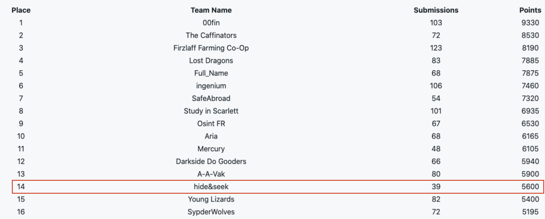
#14 out of 142 teams!
Notes:
New technique - route
Never thought my love of puzzles and video games would lead to tthis
I didn’t realise that participating in a competition would instill such a strong sense of teamwork, and that it wasn’t just the connections between us, but the connections between the teams that helped everyone succeed
Think about your affect on those around you, think about your influence
Think about the moments that create those lasting connections
Reflect on how you feel
Make big moments happen with the tools you have available

Slide 57
Twitter
Events
@AletheDenis @humanhacker @HackingDave
Trace Labs
OSINT Combine Academy
National Missing Persons

Slide 58

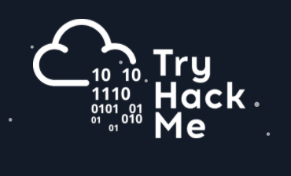

Thank you!
Notes:
CTF’s
Some of these organisations have some great, generous people –
Pam who runs haXX
Kylie who cofounded BSides Canberra
Louis who runs and writes so many great exercises at Pentester Lab
Communities and places to learn
ask for questions

